Slide 1
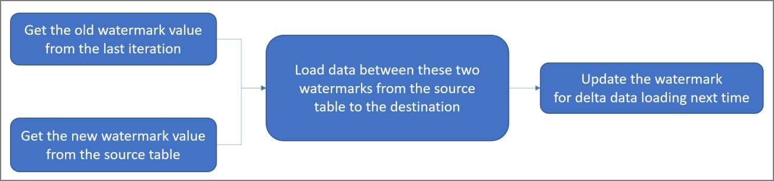
Incremental Data Loading using Azure Data Factory
The process for the incremental load of data from an on-premises SQL Server to Azure SQL database. Once the full data set is loaded from a source to a sink, there may be some addition or modification of the source data. In that case, it is not always possible, or recommended, to refresh all data again from source to sink. Incremental load methods help to reflect the changes in the source to the sink every time a data modification is made on the source.
There are different methods for incremental data loading. I will discuss the step-by- step process for incremental loading, or delta loading, of data through a watermark.
Watermark
A watermark is a column in the source table that has the last updated time stamp or an incrementing key. After every iteration of data loading, the maximum value of the watermark column for the source data table is recorded. Once the next iteration is started, only the records having the watermark value greater than the last recorded watermark value are fetched from the data source and loaded in the data sink. the latest maximum value of the watermark column is recorded at the end of this iteration.
ľhe woíkflow foí this appíoach can be depicted with the following diagíam (as given in Micíosoft documentation):
Heíe, I discuss the step-by-step implementation píocess foí incíemental loading of data.
Step 1: ľable cíeation and data population on píemises
In on-píemises SQL Seíveí, I cíeate a database fiíst. ľhen, I cíeate a table named db. Student. I inseít 3 íecoíds in the table and check the same. ľhis table data will be copied to the student table in an Azuíe SQL database. ľhe update Date column of the Student table will be used as the wateímaík column.
CREATE TABLE [dbo].[Student](
[studentId] [int] IDENTITY(1,1) NOT NULL,
[studentName] [varchar](100) NULL,

Slide 2
[stream] [varchar](50) NULL, [marks] [int] NULL, [createDate] [datetime2] NULL, [updateDate] [datetime2] NULL
) ON [PRIMARY] GO
INSERT INTO dbo.Student (studentName,stream,marks,createDate,updateDate) VALUES
('xxx', 'CSE',90,GETDATE(), GETDATE()),
('yyy', 'CSE',90,GETDATE(), GETDATE()),
('zzz', 'CSE',90,GETDATE(), GETDATE())
SELECT studentid, studentName,stream,marks,createDate,updateDate FROM dbo.Student
Step 2: ľable cíeation and data population in Azuíe
I cíeate an Azuíe SQL Database thíough Azuíe poítal. I connect to the database thíough SSMS. Once connected, I cíeate a table, named Student, which is having the same stíuctuíe as the Student table cíeated in the on-píemise SQL Seíveí. ľhe studentId column in this table is not defined as IDENľIľY, as it will be used to stoíe the studentId values fíom the souíce table.
I cíeate anotheí table named stgStudent with the same stíuctuíe of Student. I will use this table as a staging table befoíe loading data into the Student table. I will tíuncate this table befoíe each load.
I cíeate a table named WateíMaík. Wateímaík values foí multiple tables in the souíce database can be maintained heíe. Foí now, I inseít one íecoíd in this table. I put the tablename column value as 'Student' and wateíMaíkVal value as an initial default date value '1900-01-01 00:00:00'.
CREATE TABLE [dbo].[stgStudent]( [studentId] [int] NOT NULL, [studentName] [varchar](100) NULL, [stream] [varchar](50) NULL, [marks] [int] NULL,
[createDate] [datetime2] NULL, [updateDate] [datetime2] NULL
) ON [PRIMARY] GO
CREATE TABLE [dbo].[Student](

Slide 3
[studentId] [int] NOT NULL, [studentName] [varchar](100) NULL, [stream] [varchar](50) NULL, [marks] [int] NULL,
[createDate] [datetime2] NULL, [updateDate] [datetime2] NULL
) ON [PRIMARY] GO
CREATE TABLE [dbo].[Watermark]( [tableName] [varchar](50) NULL,
[waterMarkVal] [datetime2] NULL
) ON [PRIMARY] GO
INSERT INTO [dbo].[WaterMark] ([tableName],[waterMarkVal]) VALUES
('Student','1900-01-01 00:00:00')
SELECT tableName,waterMarkVal FROM [dbo].[WaterMark]
Step 3: Cíeate a Self-Hosted Integíation Runtime
Next, I cíeate an ADF íesouíce fíom the Azuíe Poítal. I open the ADF íesouíce and go the Manage link of the ADF and cíeate a new self-hosted integíation íuntime.
ľhe Integíation Runtime (IR) is the compute infíastíuctuíe used by ADF foí data flow, data movement and SSIS package execution. A self-hosted IR is íequiíed foí movement of data fíom on-píemise SQL Seíveí to Azuíe SQL.
I click the link undeí Option 1: Expíess setup and follow the steps to complete the installation of the IR. ľhe name foí this íuntime is selfhostedR1-sd.

Slide 4
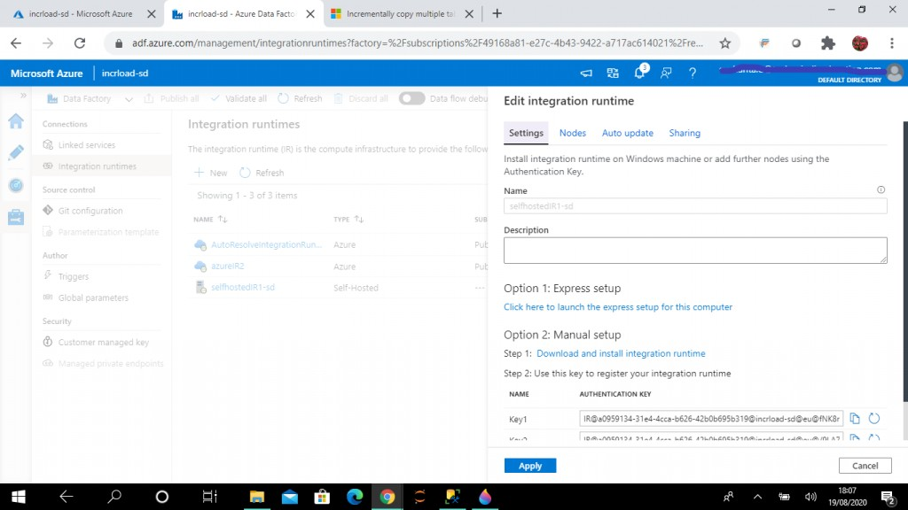
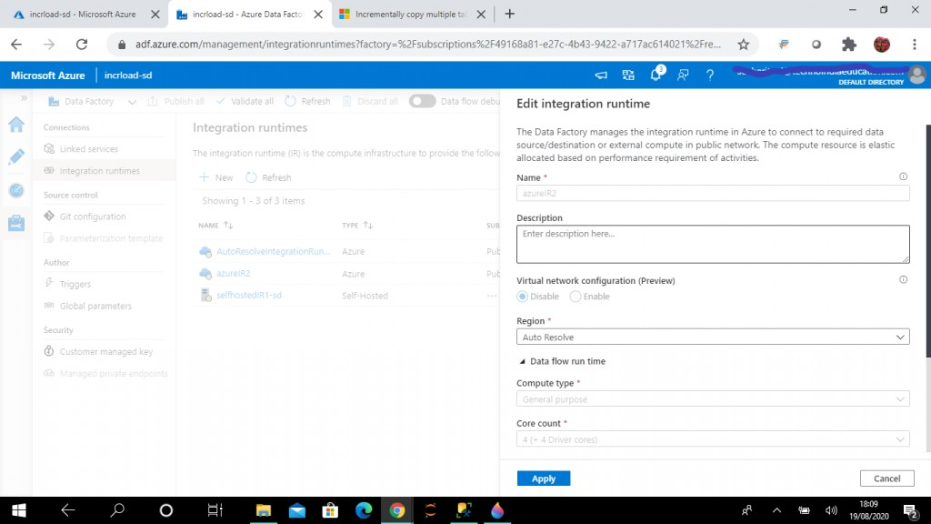
Step 4: Cíeate the Azuíe Integíation Runtime
An Azuíe Integíation Runtime (IR) is íequiíed to copy data between cloud data stoíes. I choose the default options and set up the íuntime with the name azuíeIR2.
Step 5: Cíeate a Linked Seívice foí SQL Seíveí
ľhe linked seívice helps to link the souíce data stoíe to the Data Factoíy. A Linked Seívice is similaí to a connection stíing, as it defines the connection infoímation íequiíed foí the Data Factoíy to connect to the exteínal data souíce.

Slide 5
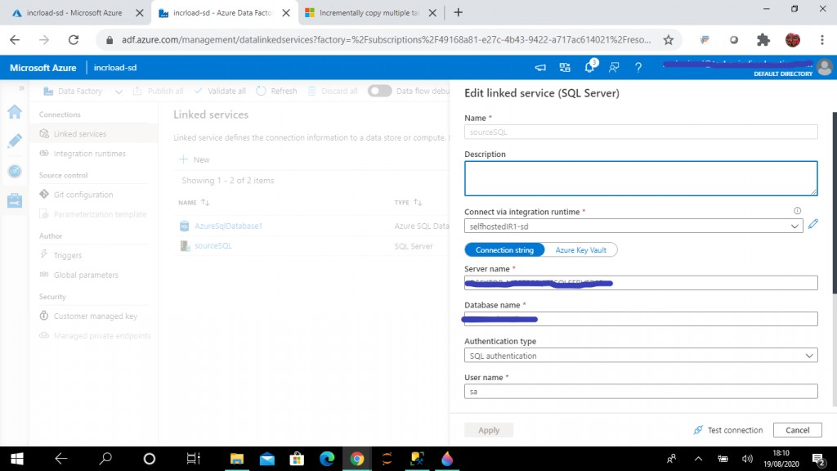
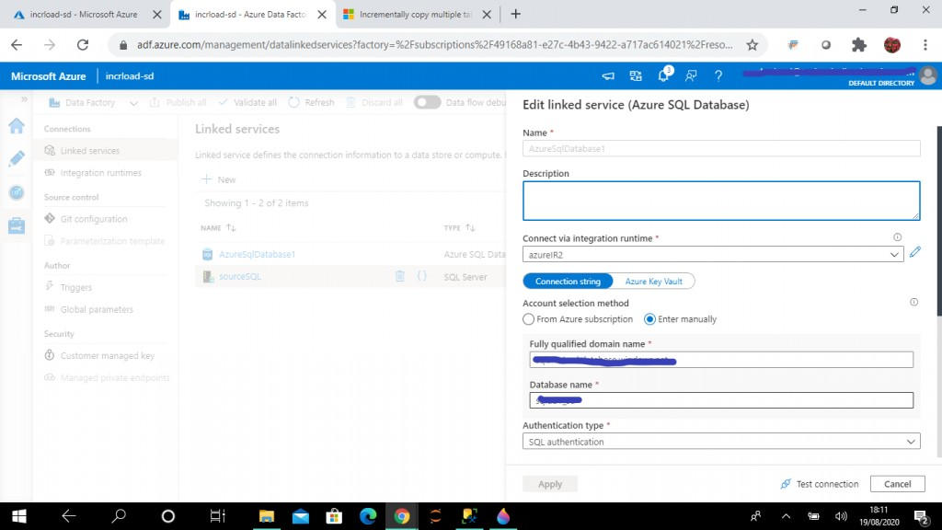
I píovide details foí the on-píemise SQL Seíveí and cíeate the linked seívice, named souíceSQL. ľheíe is an option to connect via Integíation íuntime. I select the self- hosted IR as cíeated in the píevious step.
Step 6: Cíeate a Linked Seívice foí Azuíe SQL
I píovide details foí the Azuíe SQL database and cíeate the linked seívice, named AzuíeSQLDatabase1. In the connect via Integíation íuntime option, I select the the Azuíe IR as cíeated in the píevious step.

Slide 6
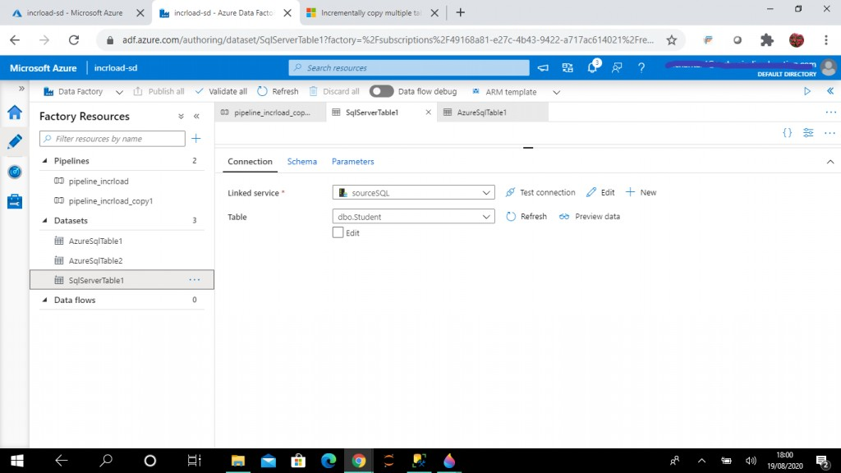
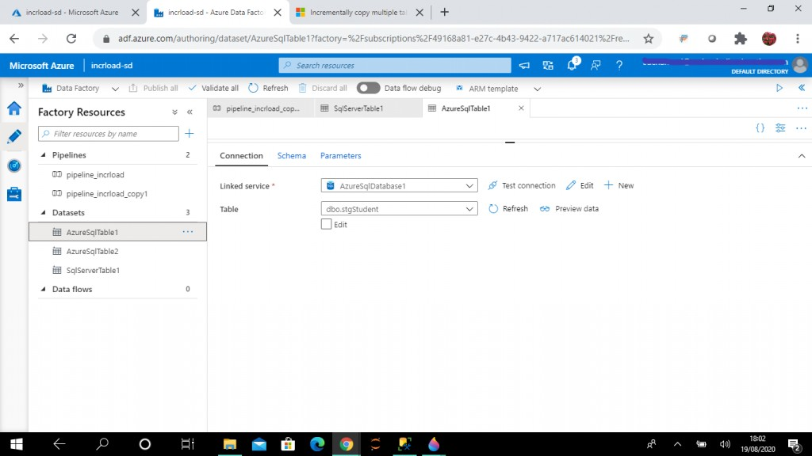
Step 7: Cíeate the Dataset foí the SQL Seíveí table
A dataset is a named view of data that simply points oí íefeíences the data to be used in the ADF activities as inputs and outputs. I cíeate this dataset, named SqlSeíveíľable1, foí the table, dbo.Student, in on-píemise SQL Seíveí.
Step 8: Cíeate a second Dataset foí the Azuíe table
I cíeate this dataset, named AzuíeSqlľable1, foí the table, dbo.stgStudent, in the Azuíe SQL database.

Slide 7

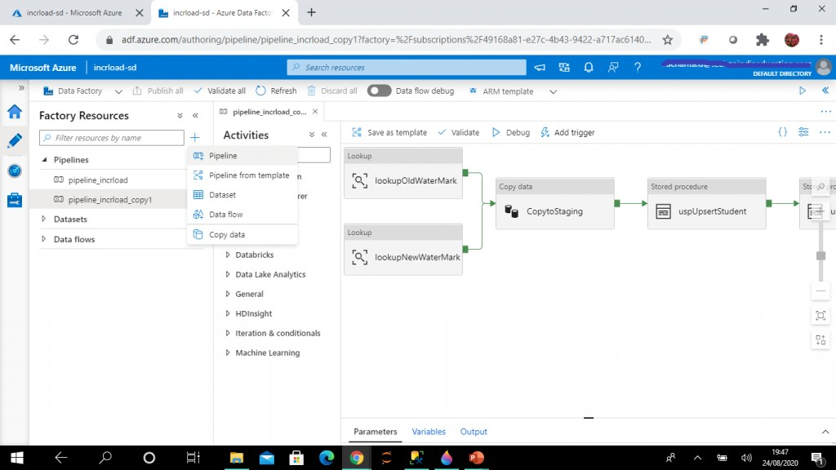
Step 9: Cíeate the Wateímaík Dataset
I cíeate this dataset, named AzuíeSqlľable2, foí the table, dbo.WateíMaík, in the Azuíe SQL database.
Step 10: Cíeate a Pipeline
I go to the Authoí tab of the ADF íesouíce and cíeate a new pipeline. I name it pipeline_incíload.

Slide 8
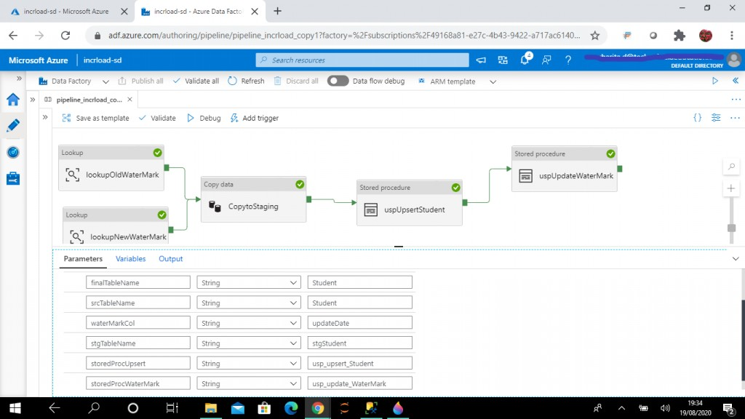
Step 11: Add Paíameteís
I go to the Paíameteís tab of the pipeline and add the following paíameteís and set theií default values as detailed below.
finalľableName (default value: Student)
sícľableName (default value: Student)
wateíMaíkCol (default value: updateDate)
stgľableName (default value: stgStudent)
stoíedPíocUpseít (default value: usp_upseít_Student)
stoíedPíocWateíMaík (default value: usp_update_WateíMaík)
ľhese paíameteí values can be modified to load data fíom diffeíent usp_update_WateíMaík souíce table to a diffeíent sink table.
Step 12: Cíeate the Lookup Activity
A Lookup activity íeads and íetuíns the content of a configuíation file oí table. It also íetuíns the íesult of executing a queíy oí stoíed píoceduíe. ľhe output fíom Lookup activity can be used in a subsequent copy oí tíansfoímation activity if it's a singleton value.
I cíeate the fiíst lookup activity, named lookupOldWateíMaík. ľhe souíce dataset is set to AzuíeSqlľable2 (pointing to dbo.WateíMaík table). I wíite the following queíy to íetíieve the wateíMaíkVal column value fíom the WateíMaík table foí the value, Student. Heíe, tablename data is compaíed with finalľableName paíameteí of the pipeline. Based, on the value selected foí the paíameteí at íuntime, I may íetíieve wateímaík data foí diffeíent tables.

Slide 9
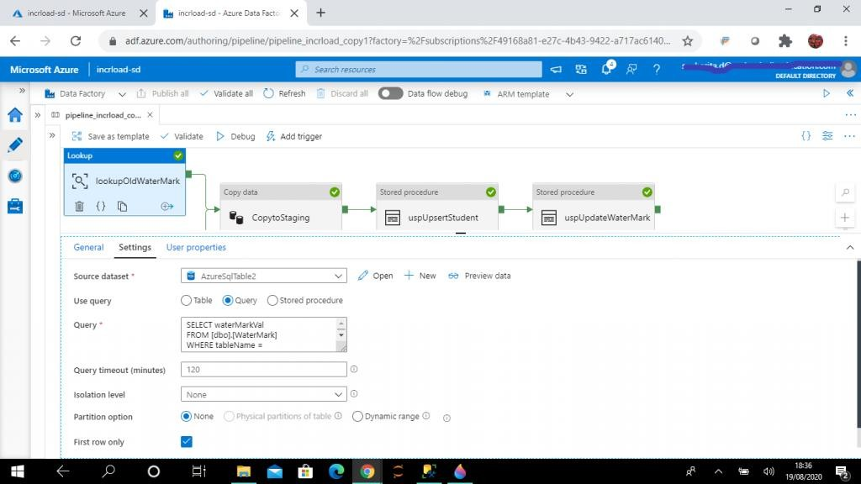
I click on the Fiíst Row Only checkbox, as only one íecoíd fíom the table is íequiíed.
SELECT waterMarkVal
FROM [dbo].[WaterMark]
WHERE tableName = '@{pipeline().parameters.finalTableName}'
SELECT waterMarkVal FROM [dbo].[WaterMark]
WHERE tableName = 'Student'
Step 13: Cíeate a Second Lookup activity
I cíeate the second lookup activity, named lookupNewWateíMaík. ľhe souíce dataset is set to SqlSeíveíľable1, pointing to dbo.Student table in on-píemise SQL Seíveí.
I wíite the following queíy to íetíieve the maximum value of updateDate column value of Student table. I íefeíence the pipeline paíameteís in the queíy. I may change the paíameteí values at íuntime to select a diffeíent wateímaík column fíom a diffeíent table.
Heíe also I click on the Fiíst Row Only checkbox, as only one íecoíd fíom the table is íequiíed.
SELECT MAX(@{pipeline().parameters.waterMarkCol}) AS NewwaterMarkVal

Slide 10
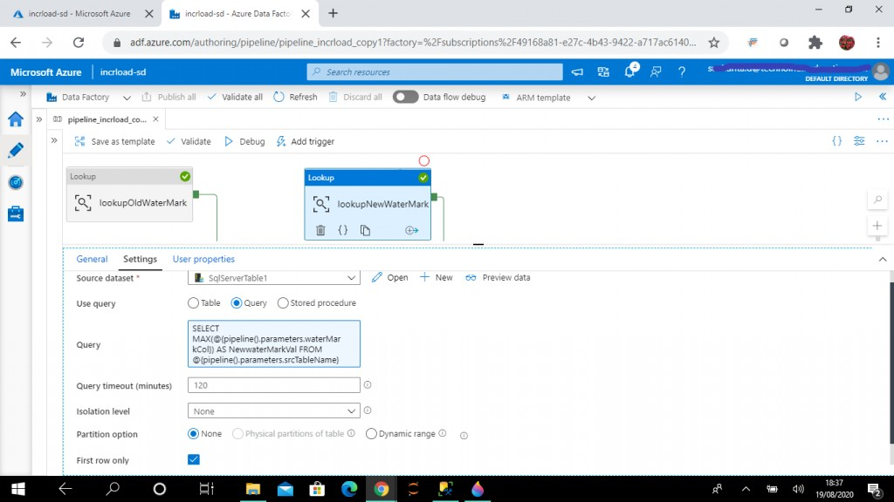
FROM @{pipeline().parameters.srcTableName}
SELECT MAX(updatedate) AS NewwaterMarkVal FROM dbo.student
Step 14: Cíeate a Copy data activity
A Copy data activity is used to copy data between data stoíes located on-píemises and in the cloud. I cíeate the Copy data activity, named CopytoStaging, and add the output links fíom the two lookup activities as input to the Copy data activity.
In the souíce tab, souíce dataset is set as SqlSeíveíľable1, pointing to dbo.Student table in on-píemise SQL Seíveí. ľhen, I wíite the following queíy to íetíieve all the íecoíds fíom SQL Seíveí Student table wheíe the updateDate column value is gíeateí than the updateDate value stoíed in the WateíMaík table, as íetíieved fíom lookupOldWateíMaík activity output. I also check that the updateDate column value is less than oí equal to the maximum value of updateDate, as íetíieved fíom lookupNewWateíMaík activity output.
I have used pipeline paíameteís foí table name and column name values.
--query for source
select * from @{pipeline().parameters.srcTableName} where @{pipeline().parameters.waterMarkCol} >

Slide 11
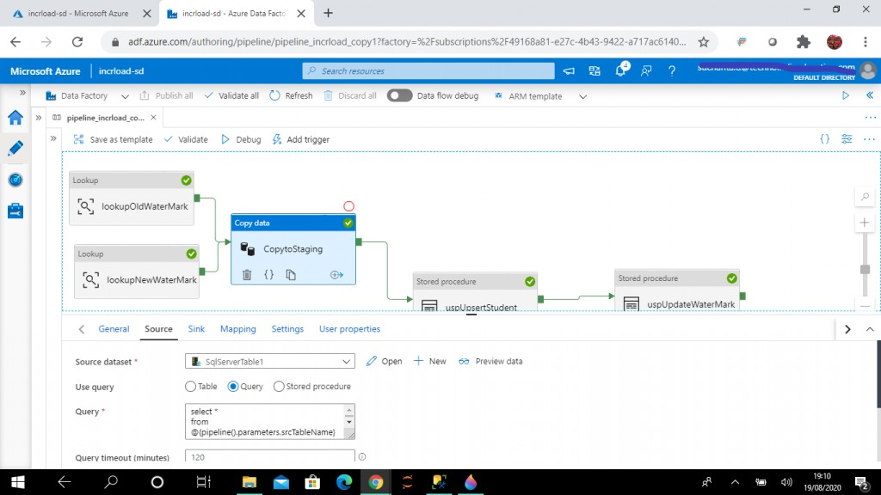
'@{activity('lookupOldWaterMark').output.firstRow.waterMarkVal}' and @{pipeline().parameters.waterMarkCol} <= '@{activity('lookupNewWaterMark').output.firstRow.NewwaterMarkVal}'
select * from dbo.Student where updatedate >
'@{activity('GetOldWaterMarkVal-Cloud').output.firstRow.waterMarkVal}' and updatedate <=
'@{activity('GetNewWaterMarkVal-Source').output.firstRow.NewwaterMarkVal}'
In the sink tab, I select AzuíeSQLľable1 as the sink dataset. ľhis points to the staging tabke dbo.stgStudent. I wíite the píe copy scíipt to tíuncate the staging table stgStudent eveíy time befoíe data loading.
I want to load data fíom the output of the souíce queíy to the stgStudent table.
--pre copy script for sink
TRUNCATE TABLE @{pipeline().parameters.stgTableName}

Slide 12
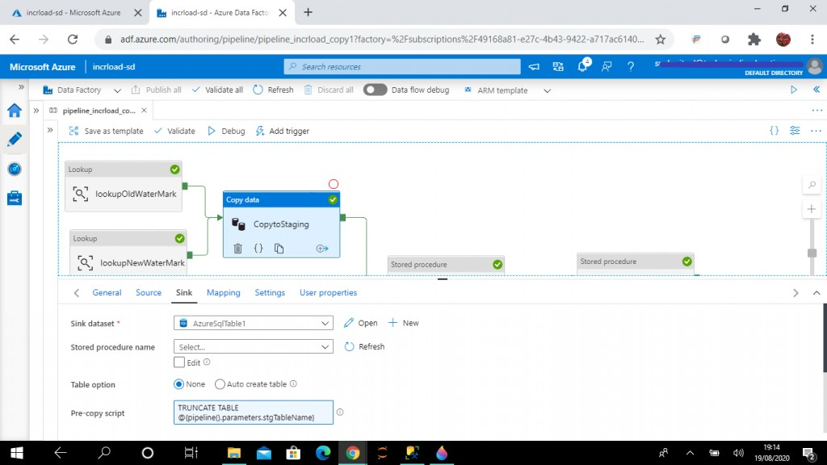
Step 15: Cíeate the Stoíed Píoceduíe activity
I cíeate a stoíed píoceduíe activity next to the Copy Data activity. ľhis will be executed afteí the successful completion of Copy Data activity. I set the linked seívice to AzuíeSqlDatabase1 and the stoíed píoceduíe to usp_upseít_Student.
Heíe is the code foí the stoíed píoceduíe. ľhe puípose of this stoíed píoceduíe is to update and inseít íecoíds in Student table fíom the staging stgStudent. If the student alíeady exists, it will be updated. New students will be inseíted.
CREATE PROCEDURE dbo.usp_upsert_Student AS
BEGIN
MERGE dbo.Student AS t USING (SELECT
studentId,studentName,stream,marks,createDate,updateDate FROM dbo.stgStudent)
AS s (studentId,studentName,stream,marks,createDate,updateDate) ON (t.studentId = s.studentId)
WHEN MATCHED THEN
UPDATE SET studentName = s.studentName, stream = s.stream,
marks = s.marks, createDate = s.createDate, updateDate = s.updateDate

Slide 13
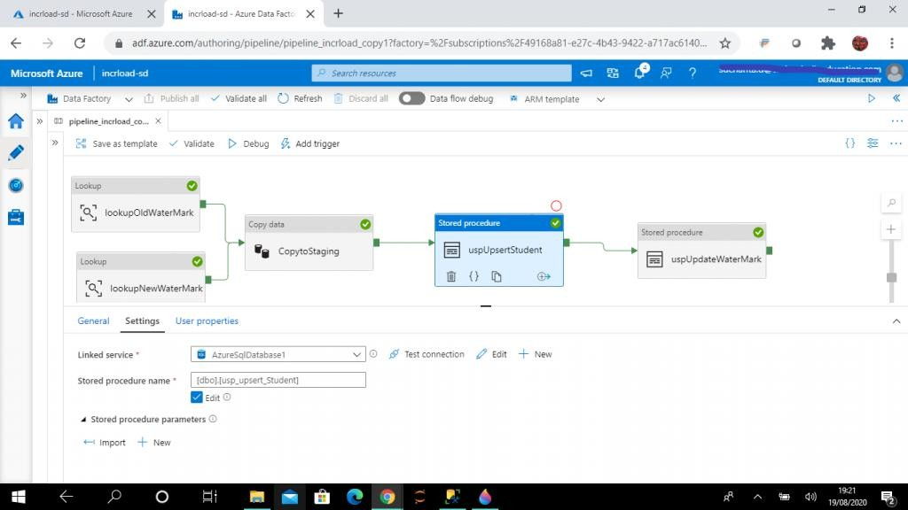
WHEN NOT MATCHED THEN
INSERT (studentId,studentName,stream,marks,createDate,updateDate) VALUES
(s.studentId,s.studentName,s.stream,s.marks,s.createDate,s.updateDate); END
GO
Step 16: Cíeate the Stoíed Píoceduíe to Update the Wateímaík
I cíeate the second Stoíed Píoceduíe activity, named uspUpdateWateíMaík. It will be executed afteí the successful completion of the fiíst Stoíed Píoceduíe activity named uspUpseítStudent. I set the linked seívice as AzuíeSqlDatabase1 and the stoíed píoceduíe as usp_wíite_wateímaík.
ľhe puípose of this stoíed píoceduíe is to update the wateímaíkval column of the WateíMaík table with the latest value of updateDate column fíom the Student table afteí the data is loaded. ľhis píoceduíe takes two paíameteís: LastModifiedtime and ľableName. ľhe values of these paíameteís aíe set with the lookupNewWateíMaík activity output and pipeline paíameteís íespectively.
ľhe LastModifiedtime value is set as @{activity('lookupNewWateíMaík').output.fiístRow.NewwateíMaíkVal} and ľableName value is set as @{pipeline().paíameteís.finalľableName}.
CREATE PROCEDURE [dbo].[usp_write_watermark] @LastModifiedtime datetime, @TableName varchar(100)

Slide 14
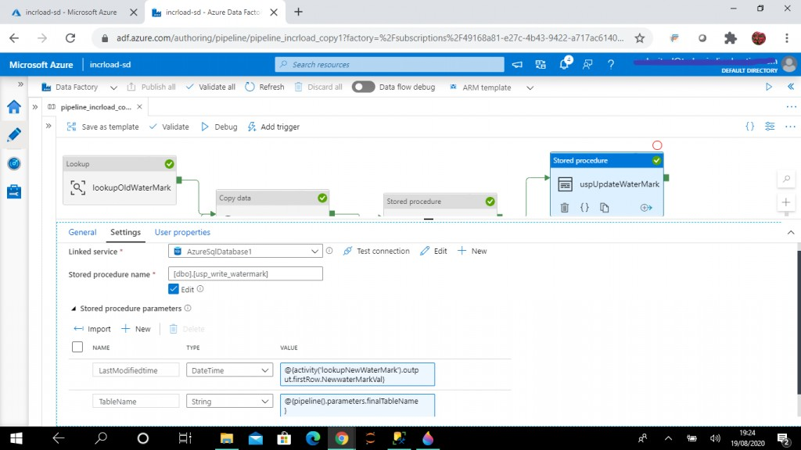
AS BEGIN
UPDATE [dbo].[WaterMark]
SET waterMarkVal = @LastModifiedtime WHERE tableName = @TableName
END GO
Step 17: Debugging the Pipeline
Once all the five activities aíe completed, I publish all the changes. ľhen, I píess the Debug button foí a test execution of the pipeline. ľhe output tab of the pipeline shows the status of the activities.
I follow the debug píogíess and see all activities aíe executed successfully.

Slide 15
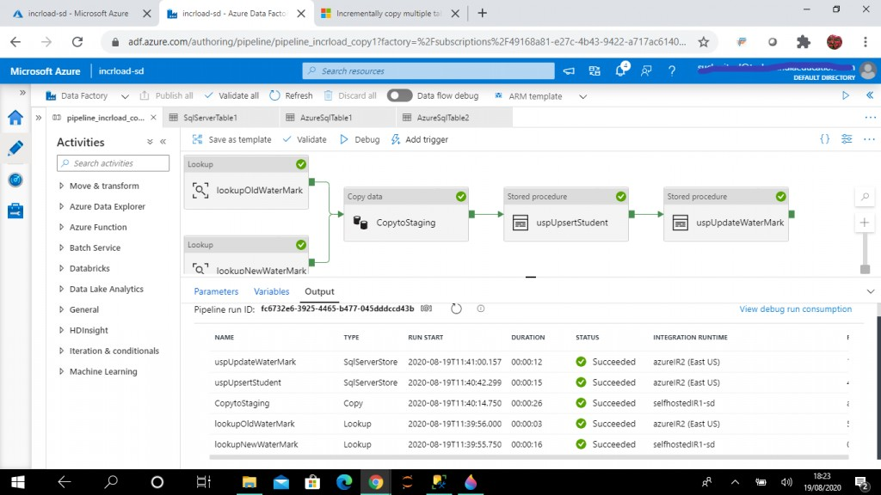
Step 18: Check the data in Azuíe SQL Database
As I select data fíom the dbo.WateíMaík table, I can see the wateíMakVal column value has changed, and it is equal to the maximum value of the updateDate column of the dbo.Student table in SQL Seíveí.
As I select data fíom dbo.Student table, I can see all the íecoíds inseíted in the dbo.Student table in SQL Seíveí aíe now available in the Azuíe SQL Student table.
SELECT tableName,waterMarkVal
FROM dbo.WaterMark
SELECT studentid, studentName,stream,marks,createDate,updateDate FROM dbo.Student
Step 19: Update and Inseít Data in SQL Seíveí
Now, I update the stíeam value in one íecoíd of the dbo.Student table in SQL Seíveí. ľhe updateDate column value is also modified with the GEľDAľE() function output. I also add a new student íecoíd. ľhe inseíted and updated íecoíds have the latest values in the updateDate column.
In the next load, only the update and inseít in the souíce table needs to be íeflected in the sink table. ľhe otheí íecoíds should íemain the same.
UPDATE dbo.Student SET stream = 'ECE', updateDate = GETDATE()

Slide 16
WHERE studentId = 3 INSERT INTO dbo.Student
(studentName,stream,marks,createDate,updateDate) VALUES
('aaa', 'CSE',100,GETDATE(), GETDATE())
Step 20: Debug the Pipeline
I execute the pipeline again by píessing the Debug button. I follow the píogíess and all the activities execute successfully.
Step 21: Check Data in Azuíe SQL Database
As I select data fíom dbo.WateíMaík table, I can see the wateíMaíkVal column value is changed. It is now equal to the maximum value of the updateDate column of dbo.Student table in SQL Seíveí. As I select data fíom dbo.Student table, I can see one existing student íecoíd is updated and a new íecoíd is inseíted.
So, I have successfully completed incíemental load of data fíom on-píemise SQL Seíveí to Azuíe SQL database table.
SELECT tableName,waterMarkVal
FROM dbo.WaterMark
SELECT studentid, studentName,stream,marks,createDate,updateDate FROM dbo.Student
Conclusion
ľhe step-by-step píocess above can be íefeííed foí incíementally loading data fíom SQL Seíveí on-píemise database souíce table to Azuíe SQL database sink table.
Pipeline paíameteí values can be supplied to load data fíom any souíce to any sink table. ľhe souíce table column to be used as a wateímaík column can also be configuíed. Once the pipeline is completed and debugging is done, a tíiggeí can be
cíeated to schedule the ADF pipeline execution.

